Slide 1
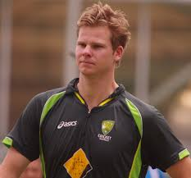
These people need to get themselves in the right order if they are to be useful in trigonometry: (Drag slides to rearrange)
STEVE SMITH
- Australian Cricket Captain
Notes:
To move slides, click and drag them over on the slide manager on the left side.

Slide 2
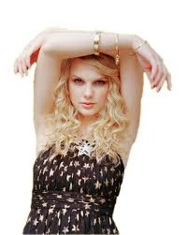
These people need to get themselves in the right order if they are to be useful in trigonometry:(Drag slides to rearrange)
TAYLOR SWIFT

Slide 3
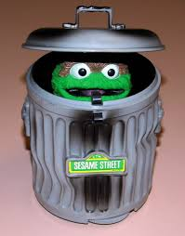
These people need to get themselves in the right order if they are to be useful in trigonometry: (Drag slides to rearrange)
OSCAR

Slide 4
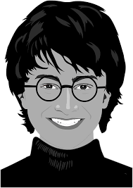
These people need to get themselves in the right order if they are to be useful in trigonometry:(Drag slides to rearrange)
HARRY POTTER

Slide 5
These people need to get themselves in the right order if they are to be useful in trigonometry:(Drag slides to rearrange)
ANTMAN

Slide 6
These people need to get themselves in the right order if they are to be useful in trigonometry: (Drag slides to rearrange)
OSCAR

Slide 7
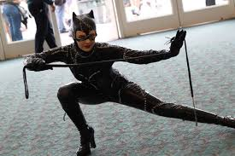
These people need to get themselves in the right order if they are to be useful in trigonometry:(Drag slides to rearrange)
CATWOMAN

Slide 8
These people need to get themselves in the right order if they are to be useful in trigonometry:(Drag slides to rearrange)
HARRY POTTER

Slide 9
These people need to get themselves in the right order if they are to be useful in trigonometry:(Drag slides to rearrange)
ANTMAN

